Slide 1


Career Accelerator
Sprint Planning
(P4)

Slide 2

In this Sprint Planning
1
Scrum application in Career Accelerator
2
Introduction to Project
3
Assessment Rubric
4
Breakout rooms & Time selection
5
How to get help

Slide 3
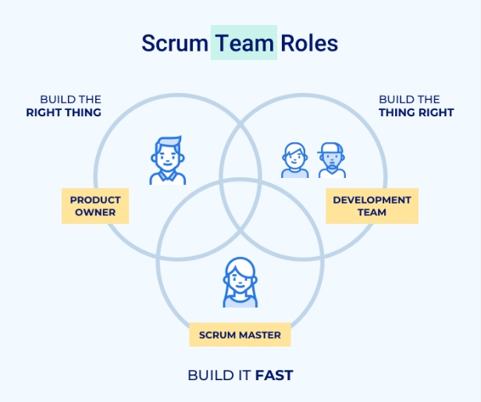
The Scrum Team

Slide 4
Scrum in Career Accelerator
To foster Scrum during every Sprint
Team members will have a weekly Team Sync (Scrum Habits) meeting with scrum masters to assess the progression of the team.
Tool to be used
Kanban Board

Slide 5
Project Introduction
Scenario: You are a data scientist, and your company wants you to create an in-house app that will allow non-technical staff to interact with a machine learning model to predict the churn of their telecommunication service.
Objectives
Create an app for the classification model you created during the LP2 project.
Your team wants to deploy this app for use by the marketing team to target customers that may churn and offer them better services.

Slide 6
Project Deliverables
Wrap your built model into a Streamlit web application.
At the end of the period, you must submit
A well-structured GitHub repository containing the codes app
An article summarizing the project
The main evaluation will be based on the submitted documents.

Slide 7
Sprint Rubrics
Excellent: Have an app that works correctly with a nice and personalized interface.
Good: Have an app that launches, makes predictions, and shows results on the interface.
Fair: Have an app that launches but has bugs in the backend regarding the interface or predictions.

Slide 8
Why is this Sprint Valuable?
Learn to embed your Machine Learning Models using powerful Python GUI frameworks like Streamlit
Learn to work in virtual environments in Python.
Document your process for solving a problem in a comprehensive approach.
Learn to use git for collaborations.

Slide 9
Sprint Backlog
Research on Streamlit
Set up project environment (Repository with ReadMe and License)
Create a virtual environment for your app.
Install Streamlit, Joblib (Any serializing package you use(d), Scikit-Learn, imbalanced-learn. Make sure that you use the same versions you used in creating and serializing your models in your notebook.
Create a folder called models and put in your model(s) and encoder from your LP2 project. -If the model has been pushed to a remote server, you can simply create a connection

Slide 10
Sprint Backlog
Your app should have the following pages app.
Home Page – This should have information about the application including a link to the source code on GitHub and links to all your social handles like GitHub, LinkedIn, Medium, etc.
Data Page – This page should display the data found in the database shared for this sprint. Connect to a database and make API calls.
Dashboard Page – Create an interactive dashboard to visualize the data from the database and derive meaningful insights.
Predict Page – On this page, the user should interact with the Machine Learning model to make predictions. Predictions should also include probabilities of accuracy.

Slide 11
Sprint Backlog
Add content to the home page last as it is a finalization of your project and more information page.
On the data page, display a sample for the data from the database, so the users can see the type of data they are working with.
On the dashboard page show the visualization based on the analysis you have made using data from the data page
Now finally on the Predict complex page,
Create a form to collect all the fields you need to pass to the model
Load the model.
Pass the collected data through the model using a custom function.
Display the output and prediction probability.

Slide 12
Sprint Backlog
Before the user gets access to the app, they have to authenticate their identity with a login form. Install streamlit-authenticator for authenticating users of your app.
Deploy the app to Streamlit Community Cloud.
Publish an article on the entire process

Slide 13
Sprint (4 Weeks)
 | MON | TUE | WED | THUR | FRI
Week 1 | Sprint Planning (4-6 pm GMT) | Team Sync (Scrum Habits) (9:00 - 9:20 am GMT) |  | Engineering Demo (4-6pm GMT)
Week 2 | Team Demo (4-6pm GMT) | Team Sync (Scrum Habits) (9:00 - 9:20 am GMT) |  | Engineering Demo (4-6pm GMT)
Week 3 | Team Demo (4-6pm GMT) | Team Sync (Scrum Habits) (9:00 - 9:20 am GMT) |  | Engineering Demo (4-6pm GMT)
Week 4 | Team Demo (4-6pm GMT) | Team Sync (Scrum Habits) (9:00 - 9:20 am GMT) |  | Sprint Retrospective (4-6pm GMT)

Slide 14
Sprint Timeline (4 Weeks)
You will submit a weekly quiz for the first 3 weeks.
The final week is the project submission week
Sprint Deadline: August 5th – September 1st, 2024

Slide 15
How to get help
These projects are designed to get you to do extensive research on the topic at hand and so we expect you to go out and find answers. However, if you really need to speak to/or ask an instructor a question outside of engagement times:
Please post all your questions in the dedicated channel. i.e. the channel with the name of the current project.
Please tag the instructor and give a descriptive assessment of the problem with good screenshots.
Please utilize the materials curated for you on the Thinkific platform.
Finally, please fill out the weekly surveys, at the end of week, and let us know how we can improve the program for you.

